Slide 1
Peter Collins
Dandenong High School
Peter.Collins@education.vic.gov.au
Some Ideas about How to teach Algebra that I have used
(38 dazzling powerpoint slides)

Slide 2

Algebra is an abbreviation system, a shortcut to save time and writing

Slide 3
Lesson Objective:- To improve your capacity to teach Algebra, more effectively and calmly
Success criteria:- To ask questions, and / or make a note mental or otherwise of the ideas and approaches espoused, and reflect on how much of this stuff is useful / relevant to you.

Slide 4
Todays Content
38 slides with suggestions on teaching Algebra
Some nice pictures
Opportunity to ask random questions, some of which may get answered satisfactorily.

Slide 5
Why Algebra?
To save lots of time and writing. Proper algebra is a shortcut / code for stuff that otherwise takes too much time to write out.
Because it’s tricky, and if you can understand it you are cleverer than people who don’t, and because it’s important (otherwise it wouldn’t be in the book)
Hint – 2. Is not really valid, although lots of people and traditional teaching techniques act like it is

Slide 6
Why Algebra?
BIG IDEA
Proper algebra is a shortcut / code for stuff that otherwise takes too much time to write out.
(You do need to know what the letters stand for.)
Notes:
Algebra has meaning

Slide 7
Why this lecture?
In Teacher’s College (Rusden 1988) I attended a Studies in teaching Maths lecture where they pointed out, using various texts, that Algebra was taught really badly.
Looking at today’s texts (with associated on line bells and whistles) and data such as Naplan, not a lot has changed.
+ It is still taught as a disparate list of barely related context free topics, a puddle of random algorithms, rather than a coherent, inter related whole (like a lot of maths)
We can do better

Slide 8
Algebra – sub topics (as a list)
Substitution.
Simplification – to make some substitution easier, show what works and what doesn’t
Simple linear equation solving, leading on to more complex linear equation solving
Other algebra tricks eg expansion
Expansion as the opposite of factorisation
The null factor law
Finding the rule
Plotting coordinates
Transposing
Index laws

Slide 9
Algebra mind map
Multi step Equation solving
Transposing
Simple Equation solving
Index Laws
SUBSTITUTION
Find the Rule
Simplification
Show when simplification works and when it doesn’t
Expansion
Using a rule to fill in an x / y table (and then plotting points on a graph)
Factorising
Solving using null factor law

Slide 10
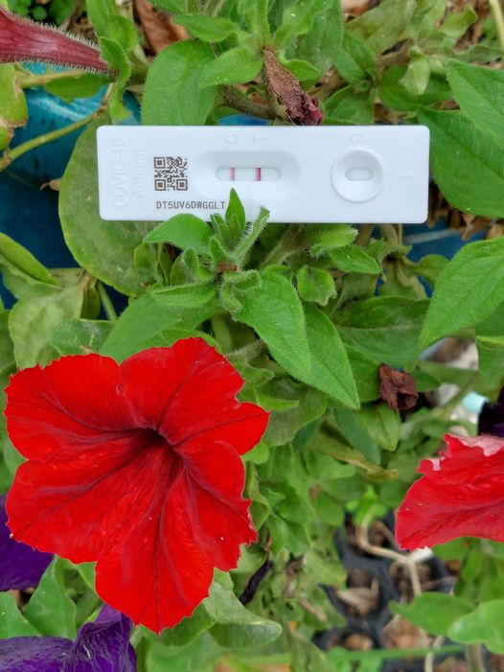
SUBSTITUTION
(It’s all about the presentation)

Slide 11
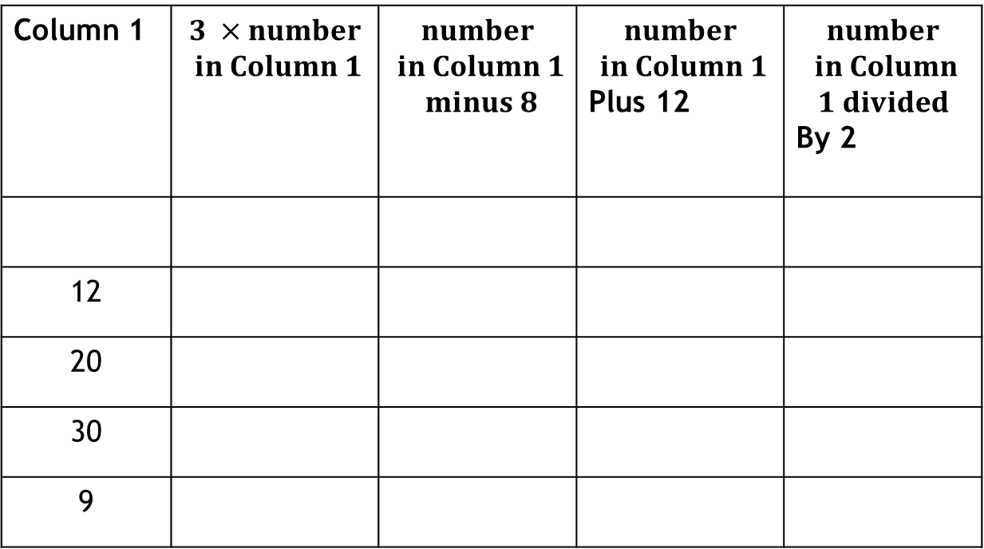
Substitution without Algebra
Fill in the table below:-
Column 1 | $$3 ×number$$ $$in Column 1$$ | $$number$$ $$in Column 1$$ $$minus 8$$ | $$number$$ $$in Column 1$$ Plus 12 | $$number$$ $$in Column$$ $$1 divided$$ By 2
12
20
30
9

Slide 12

Substitution with Algebra
Insert letter “a” with the understanding that it stands for the number in column 1 . Prompt for the rest.
Column 1 | $$3 ×number$$ $$in Column 1$$ | $$number$$ $$in Column 1$$ $$minus 8$$ | $$number$$ $$in Column 1$$ Plus 12 | $$number$$ $$in Column$$ $$1 divided$$ By 2
a | 3 x a or 3a or a x 3 | a - 8 | a + 12 | $$a ÷2 or \frac{a}{2}$$
12
20
30
9
Notes:
This one equates the meaning, with the shortcut. Students need both. The meaning is great, but takes too long to write. The shortcut by itself, is merely a potentially confusing meaningless algorithm
Is it nice if students are good with their mental arithmetic and tables? Yes BUT that’s not what we are teaching.

Slide 13
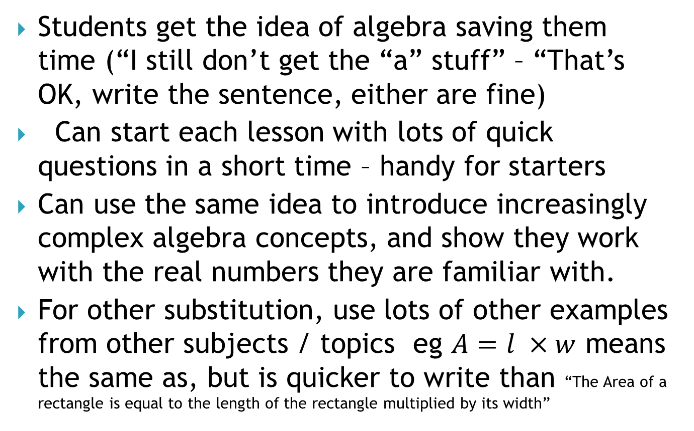
Substitution Table – Features
Students get the idea of algebra saving them time (“I still don’t get the “a” stuff” – “That’s OK, write the sentence, either are fine)
Can start each lesson with lots of quick questions in a short time – handy for starters
Can use the same idea to introduce increasingly complex algebra concepts, and show they work with the real numbers they are familiar with.
For other substitution, use lots of other examples from other subjects / topics eg $A=l ×w$ means the same as, but is quicker to write than “The Area of a rectangle is equal to the length of the rectangle multiplied by its width”

Slide 14
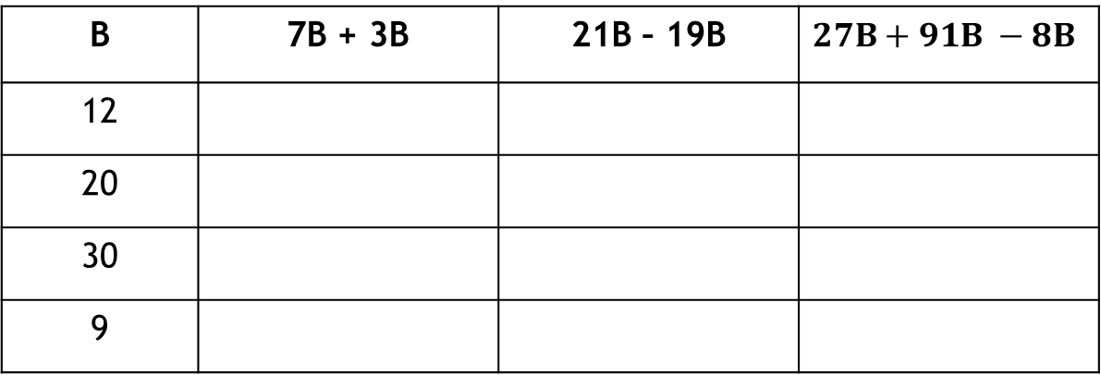
More Substitution
Get students to fill in the table – with calculators.
Students will find cheat / shortcuts i.e. discover simplification and its purpose i.e. it saves time when the letters are the same (like terms) NOT because 7 bananas + 3 bananas = 10 bananas
B | 7B + 3B | 21B – 19B | $$27B+91B −8B$$
12
20
30
9
Notes:
Once they have done this, make sure that any follow up text questions do the same. Simplify and then substitute questions are the best
Avoid those ones with pictures of apples etc
It is set outs like this that I use to demonstrate the index laws

Slide 15
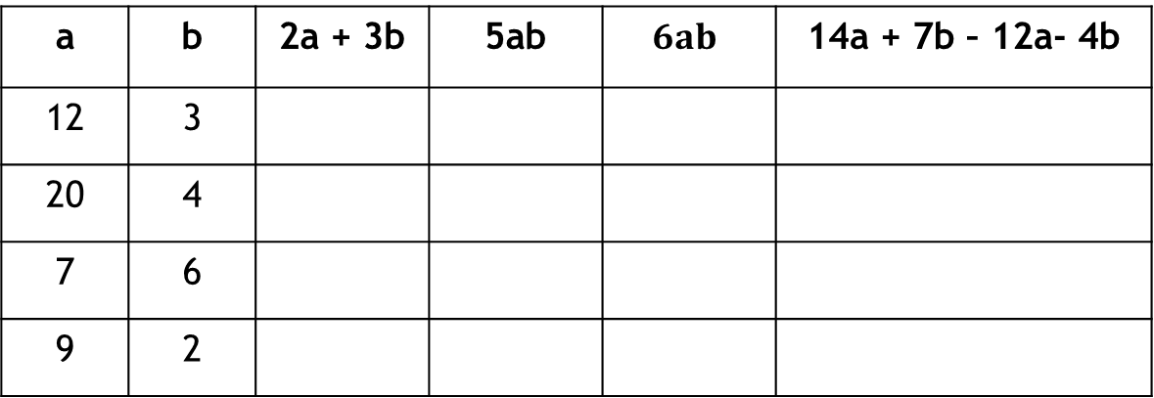
Simplification with two letters
After doing this, students should see that 2a+ 3b is not equal 5ab or 6ab. i.e. different letters means can’t be simplified because the answers are different NOT because you can’t add apples to bananas.
They will also see that 14a +7b-12a-4b simplifies to 2a + 3b (thus demonstrating simplifying using like terms)
a | b | 2a + 3b | 5ab | $$6ab$$ | 14a + 7b – 12a- 4b
12 | 3
20 | 4
7 | 6
9 | 2

Slide 16
Simplification with two letters
After doing this, students should see that 7a + 3p + 3a – 2p simplifies to 10a + p (not one term, but still simpler) (p.s. It is not equal 11ap thus reinforcing previous slide)
a | p | 7a + 3p + 3a – 2p | 10a + p | 11ap
12 | 3
20 | 4
7 | 6
9 | 2

Slide 17
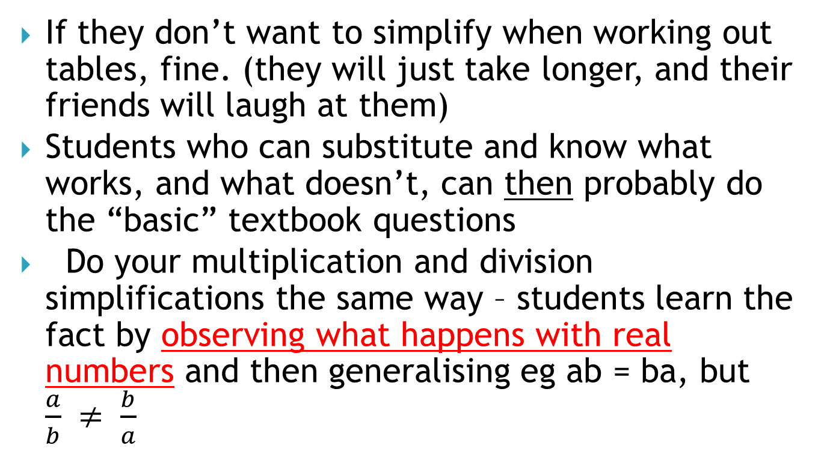
Simplification
If they don’t want to simplify when working out tables, fine. (they will just take longer, and their friends will laugh at them)
Students who can substitute and know what works, and what doesn’t, can then probably do the “basic” textbook questions
Do your multiplication and division simplifications the same way – students learn the fact by observing what happens with real numbers and then generalising eg ab = ba, but $\frac{a}{b} ≠ \frac{b}{a}$

Slide 18
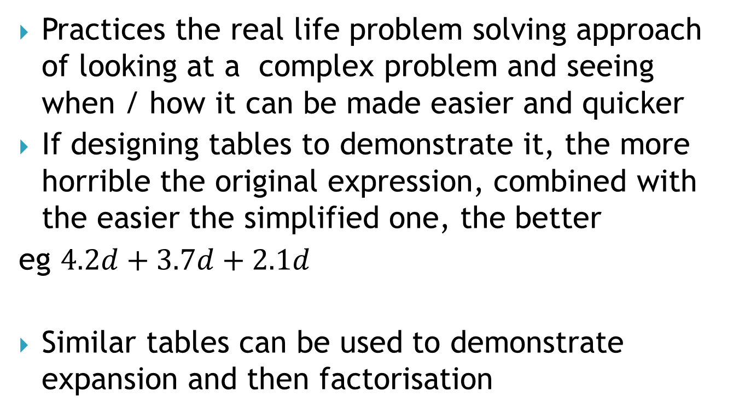
Simplification
Practices the real life problem solving approach of looking at a complex problem and seeing when / how it can be made easier and quicker
If designing tables to demonstrate it, the more horrible the original expression, combined with the easier the simplified one, the better
eg $4.2d+3.7d+2.1d$
Similar tables can be used to demonstrate expansion and then factorisation

Slide 19
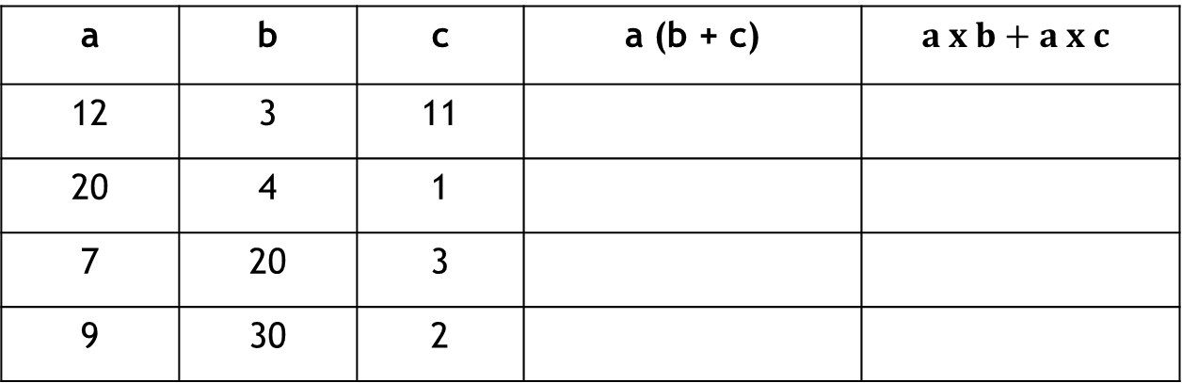
Expansion
After doing this, students should see that the two sets of answers are the same.
You are still supposed to do the brackets first, but this is an advanced technique for when you don’t want to
a | b | c | a (b + c) | $$a x b+a x c$$
12 | 3 | 11
20 | 4 | 1
7 | 20 | 3
9 | 30 | 2

Slide 20
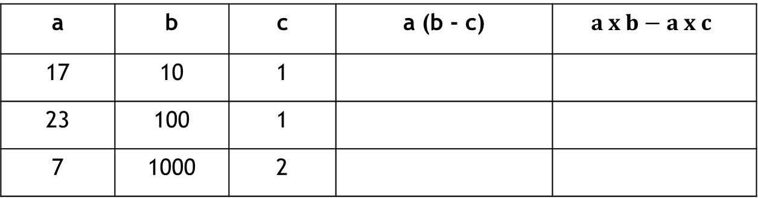
More Expansion – why bother?
After doing this, students should still see that the two sets of answers are the same, but expanding it is (sometimes) easier than doing the brackets.
a | b | c | a (b - c) | $$a x b−a x c$$
17 | 10 | 1
23 | 100 | 1
7 | 1000 | 2

Slide 21
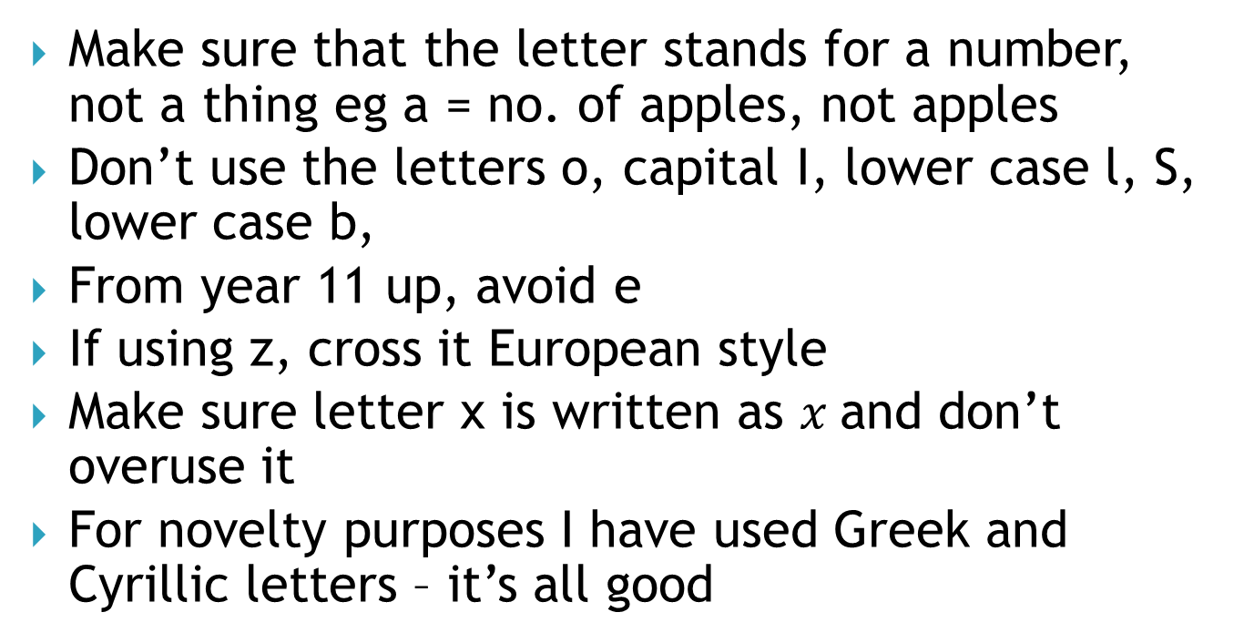
Algebra warnings
Make sure that the letter stands for a number, not a thing eg a = no. of apples, not apples
Don’t use the letters o, capital I, lower case l, S, lower case b,
From year 11 up, avoid e
If using z, cross it European style
Make sure letter x is written as $x$and don’t overuse it
For novelty purposes I have used Greek and Cyrillic letters – it’s all good

Slide 22
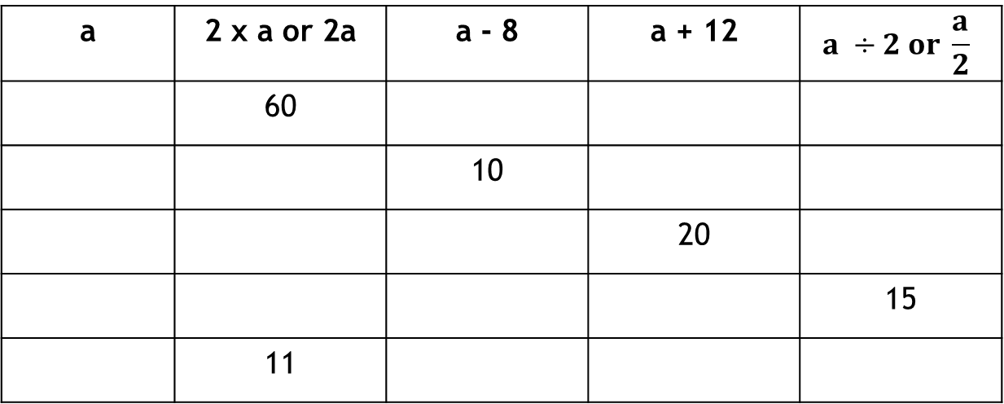
Equation solving
Like the substitution idea, but in reverse
i.e. first find the number you started with to get the answer
This is basic one step linear equation solving (the link with substitution being pretty obvious)
a | 2 x a or 2a | a - 8 | a + 12 | $$a ÷2 or \frac{a}{2}$$
 | 60
 |  | 10
 |  |  | 20
 |  |  |  | 15
 | 11

Slide 23


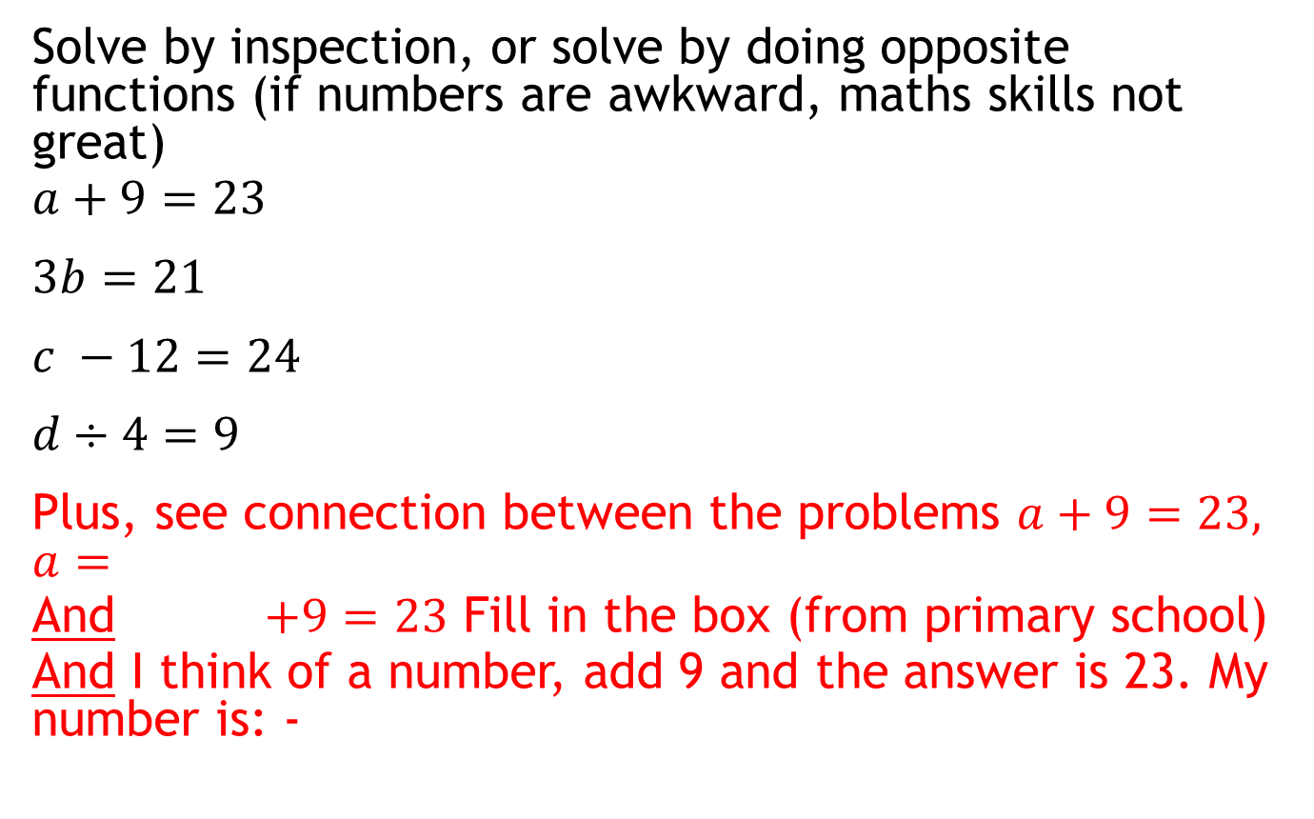


OR Single step equation solving
Solve by inspection, or solve by doing opposite functions (if numbers are awkward, maths skills not great)
$a+9=23$
$3b=21$
$c −12=24$
$d÷4=9$
Plus, see connection between the problems $a+9=23, a=$
And $+9=23$ Fill in the box (from primary school)
And I think of a number, add 9 and the answer is 23. My number is: -
$$−9$$
$$÷3$$
$$+12$$
$$×4$$

Slide 24

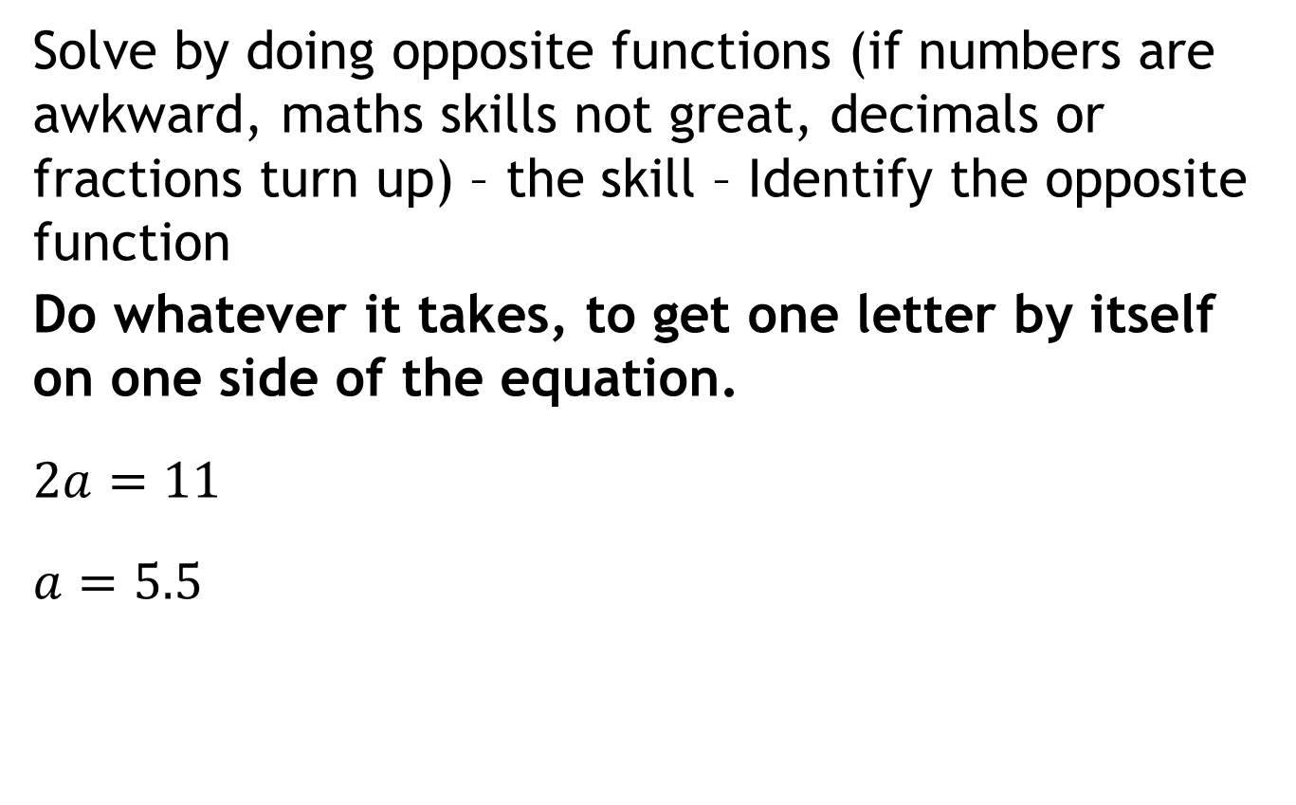
Eg of Single step equation solving
Solve by doing opposite functions (if numbers are awkward, maths skills not great, decimals or fractions turn up) – the skill – Identify the opposite function
Do whatever it takes, to get one letter by itself on one side of the equation.
$2a=11$
$a=5.5$
$$÷2$$

Slide 25
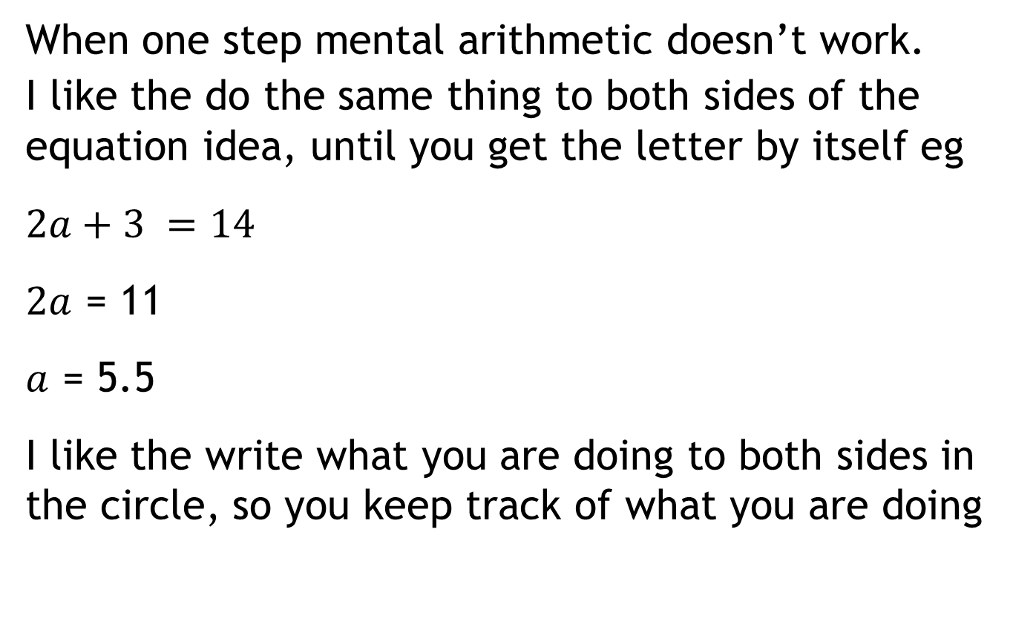


Multi step equation solving
When one step mental arithmetic doesn’t work.
I like the do the same thing to both sides of the equation idea, until you get the letter by itself eg
$2a+3 =14$
$2a$ = 11
$a$ = 5.5
I like the write what you are doing to both sides in the circle, so you keep track of what you are doing
$$−3$$
$$÷2$$
Notes:
The writing in the circle is my thing, it is not in the books
Do the same thing to both sides makes sense.
“Swap it to the other side” does not, leads to errors, and does not have a “why?” answer that’s worth much

Slide 26

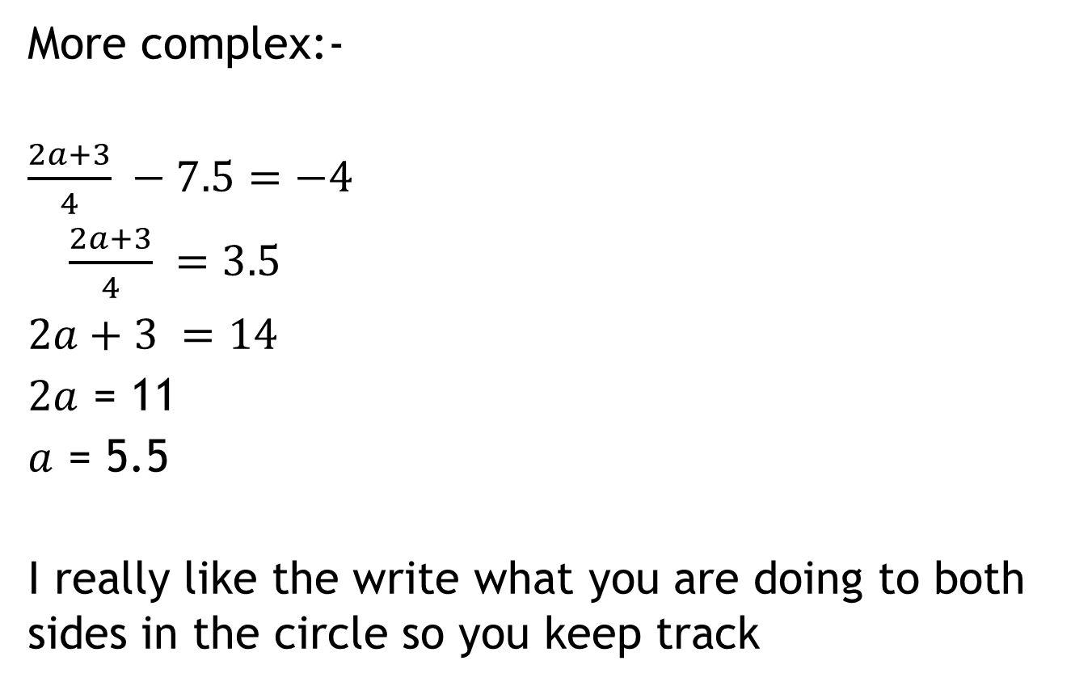



Multi step equation solving
More complex:-
$\frac{2a+3}{4} −7.5=−4$
$\frac{2a+3}{4} =3.5$
$2a+3 =14$
$2a$ = 11
$a$ = 5.5
I really like the write what you are doing to both sides in the circle so you keep track
$$+7.5$$
$$×4$$
$$−3$$
$$÷2$$

Slide 27


More Multi step equation solving
More than one letter? do the same thing to both sides of the equation idea
$9a+3 =7a+14$
$2a+3 =14$
$2a$ = 11
$a$ = 5.5
$$−7a$$
$$−3$$
$$÷2$$

Slide 28
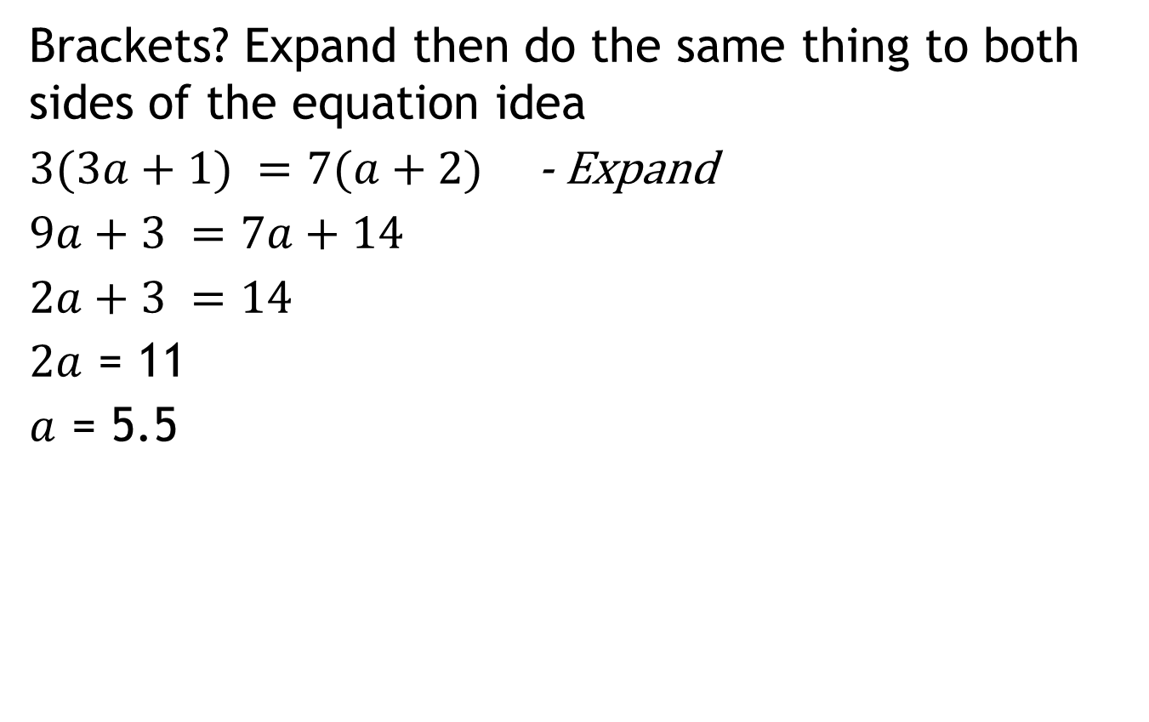
Even More Multi step equation solving
Brackets? Expand then do the same thing to both sides of the equation idea
$3(3a+1) =7(a+2)$ - Expand
$9a+3 =7a+14$
$2a+3 =14$
$2a$ = 11
$a$ = 5.5
$$−7a$$
$$−3$$
$$÷2$$

Slide 29


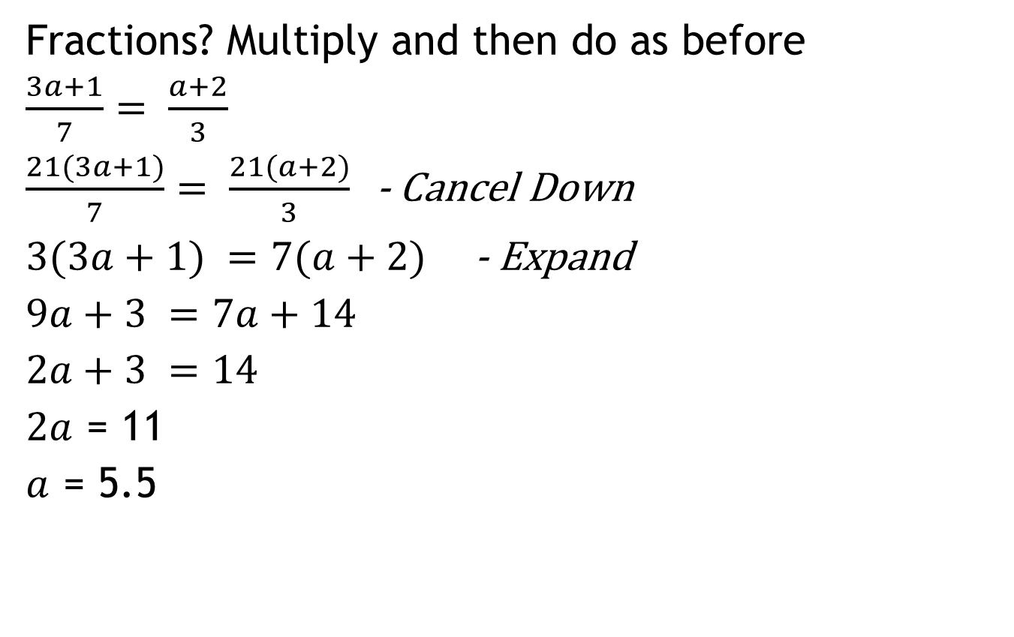
Even More Multi step equation solving
Fractions? Multiply and then do as before
$\frac{3a+1}{7}= \frac{a+2}{3}$
$\frac{21(3a+1)}{7}= \frac{21(a+2)}{3}$ - Cancel Down
$3(3a+1) =7(a+2)$ - Expand
$9a+3 =7a+14$
$2a+3 =14$
$2a$ = 11
$a$ = 5.5
x $21$
$$−7a$$
$$−3$$
$$÷2$$

Slide 30




Even More Multi step equation solving
OR
$\frac{3a+1}{7}= \frac{a+2}{3}$
$\frac{3(3a+1)}{21}= \frac{7(a+2)}{21}$ then
$3(3a+1) =7(a+2)$ - Expand
$9a+3 =7a+14$
$2a+3 =14$
$2a$ = 11
$a$ = 5.5
Common denominator = $21$
$$−7a$$
$$−3$$
$$÷2$$

Slide 31
Multi step equation solving
Some like backtracking using boxes – this is fine and the maths is identical
Avoid phrases such as “Swap to the other side” “do the opposite” – they are not that sound and can confuse
NB the more “complicated” sums all simplify down to the easier ones. (All my examples turned to 2a = 11) i.e. later stuff connects obviously to early stuff
I like the write what you are doing to both sides in the circle so you keep track approach

Slide 32
Multi step equation solving
Note – my examples are interconnected. This is deliberate.

Slide 33
Transposing eg A = L x W, P = 2L + 2W
Line 1 is just substitution
Line 2 – 3 solve using A = L x W, then sub to get P
Line 4 solve using P = 2L + 2W, then sub to get A
L | W | A | P
10 | 4
 | 4 | 36
2 |  | 50
 | 2 |  | 50

Slide 34
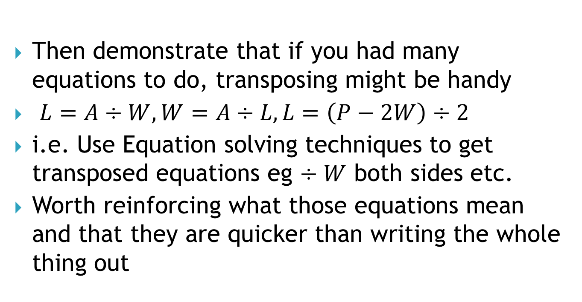
Transposing – as an extension of Equation Solving
Then demonstrate that if you had many equations to do, transposing might be handy
$L=A÷W,W=A÷L, L=\left(P−2W\right)÷2$
i.e. Use Equation solving techniques to get transposed equations eg $÷W$ both sides etc.
Worth reinforcing what those equations mean and that they are quicker than writing the whole thing out

Slide 35
Algebra Conclusions
Keep using algebra at all opportunities – especially substitution eg When doing measurement write “The Area of a rectangle is equal to the length multiplied by the width” and “A = L x W” and tell them to choose whichever one they like.
Teach using real numbers first, and then generalise, and show how algebra is a short way of describing the generalisation. (Always welcome to write it in full – they won’t)

Slide 36
Algebra Conclusions
It all starts with substitution
Everything else links to it – make the links explicit
Teach / demonstrate / have them discover using real numbers first, and then generalise, and make clear how algebra is a short way of describing the generalisation. (I do index laws the same way)

Slide 37
Algebra Conclusions
Keep attempting to link each “new” skill to the previous ones, i.e. as variants of existing knowledge rather than a brand new dot point to memorise
If you can use the skills in other topics eg whole numbers, do so.
If the text starts with simplification rather than substitution, do sub first.
Do some simple equation solving at the same time as basic algebra – it shows what it is useful for. (Even if it’s in a different chapter)
The above two points? – The book works for you, not vice versa.

Slide 38

The End.

